Slide 1
Chapter – 3
File Organization and Indexing

Slide 2
Outline
Types of Single-level Ordered Indexes
  Primary Indexes
  Clustering Indexes
  Secondary Indexes
Multilevel Indexes
Dynamic Multilevel Indexes Using B-Trees and B+-Trees

Slide 3
Introduction
Indexes
  Additional auxiliary access structures - used to speed up the retrieval of records in response to certain search conditions
  Enable efficient access to records based on the indexing fields that are used to construct the index
  Any field of the file can be used to create an index, and multiple indexes on different fields-as well as indexes on multiple fields-can be constructed on the same file
  A variety of indexes are possible; each of them uses a particular data structure to speed up the search
    To find a record or records in the data file based on a search condition on an indexing field, the index is searched, which leads to pointers to one or more disk blocks in the data file where the required records are located

Slide 4
Indexes as Access Paths
A single-level index is an auxiliary file that makes it more efficient to search for a record in the data file
The index is usually specified on one field of the file (although it could be specified on several fields)
One form of an index is a file of entries <field value, pointer to record>, which is ordered by field value
The index is called an access path on the field
Index file - usually occupies considerably less disk blocks than the data file because its entries are much smaller
A binary search on the index yields a pointer to the file record

Slide 5
Indexes as Access Paths
Indexes can also be characterized as dense or sparse
  A dense index has an index entry for every search key value (and hence every record) in the data file
  A sparse (or nondense) index, on the other hand, has index entries for only some of the search values
Example: Given the following data file EMPLOYEE(NAME, SSN, ADDRESS, JOB, SAL, ... )
Suppose that
  Record size R=150 bytes Block size B=512 bytes r=30000 records
Then, we get:
  blocking factor Bfr= B div R= 512 div 150= 3 records/block
  number of file blocks b= (r/Bfr)= (30000/3)= 10000 blocks

Slide 6
Indexes as Access Paths
For an index on the SSN field, assume the field size V_{SSN}=9 bytes, assume the record pointer size P_{R}=7 bytes. Then:
  Idex entry size R_{I}=(V_{SSN}+ P_{R})=(9+7)=16 bytes
  Index blocking factor Bfr_{I}= B div R_{I}= 512 div 16= 32 entries/block
  Number of index blocks b= (r/ Bfr_{I})= (30000/32)= 938 blocks
  Binary search needs log₂bI= log₂938= 10 block accesses
  This is compared to an average linear search cost of:
    (b/2)= 30000/2= 15000 block accesses
  If the file records are ordered, the binary search cost would be:
    log₂b= log₂30000= 15 block accesses

Slide 7
Types of Single-Level Indexes
Types of Single-level Indexes
  Primary Indexes
  Clustering Indexes
  Secondary Indexes

Slide 8
Types of Single-Level Indexes
Primary Index
  Defined on an ordered data file
  The data file is ordered on a key field
  Includes one index entry for each block in the data file
    The index entry has the key field value for the first record in the block, which is called the block anchor
  A similar scheme can use the last record in a block
  A primary index is a nondense (sparse) index, since it includes an entry for each disk block of the data file and the keys of its anchor record rather than for every search value
Each index entry has the value of the primary key field for the first record in a block and a pointer to that block as its two fields : index entry i as <K(i), P(i)>

Slide 9
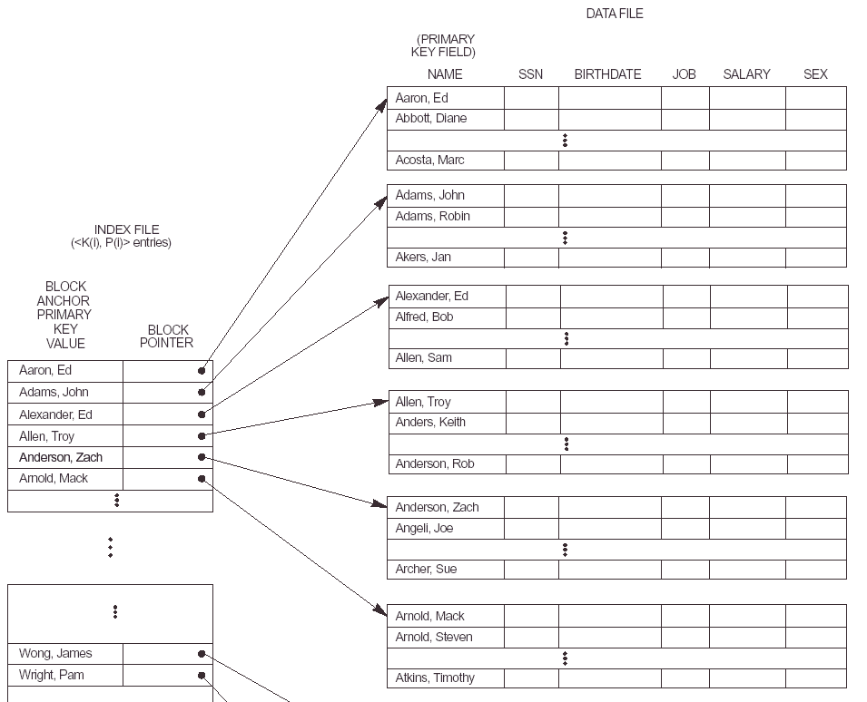
Types of Single-Level Indexes

Slide 10
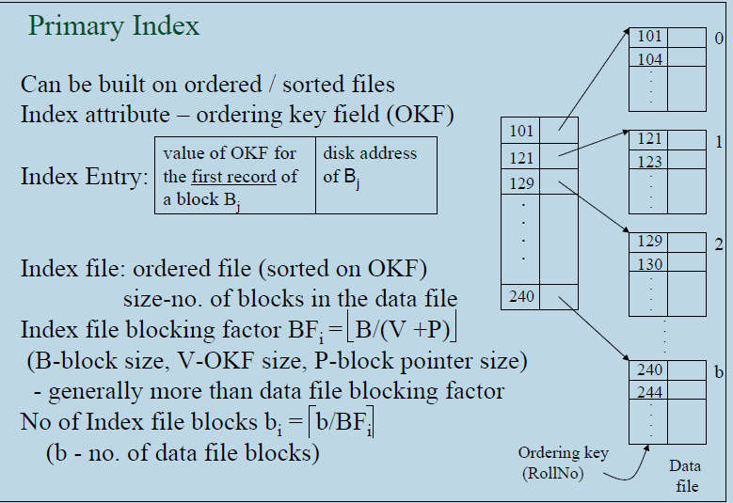

Slide 11
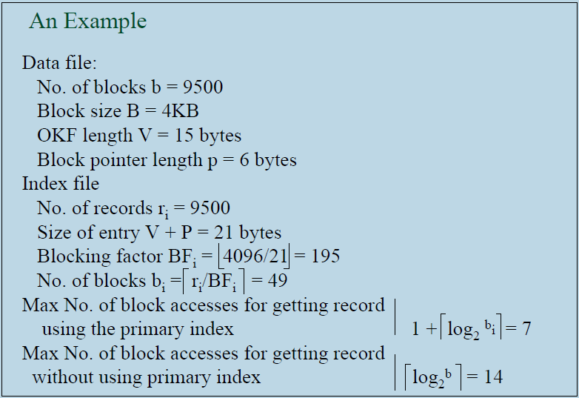

Slide 12
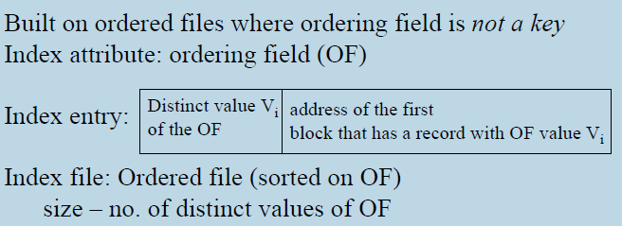
Types of Single-Level Indexes
Clustering Indexes
  Defined on an ordered data file
  The data file is ordered on a non-key field unlike primary index, which requires that the ordering field of the data file have a distinct value for each record
  Includes one index entry for each distinct value of the field; the index entry points to the first data block that contains records with that field value.
  It is another example of nondense index where Insertion and Deletion is relatively straightforward with a clustering index

Slide 13
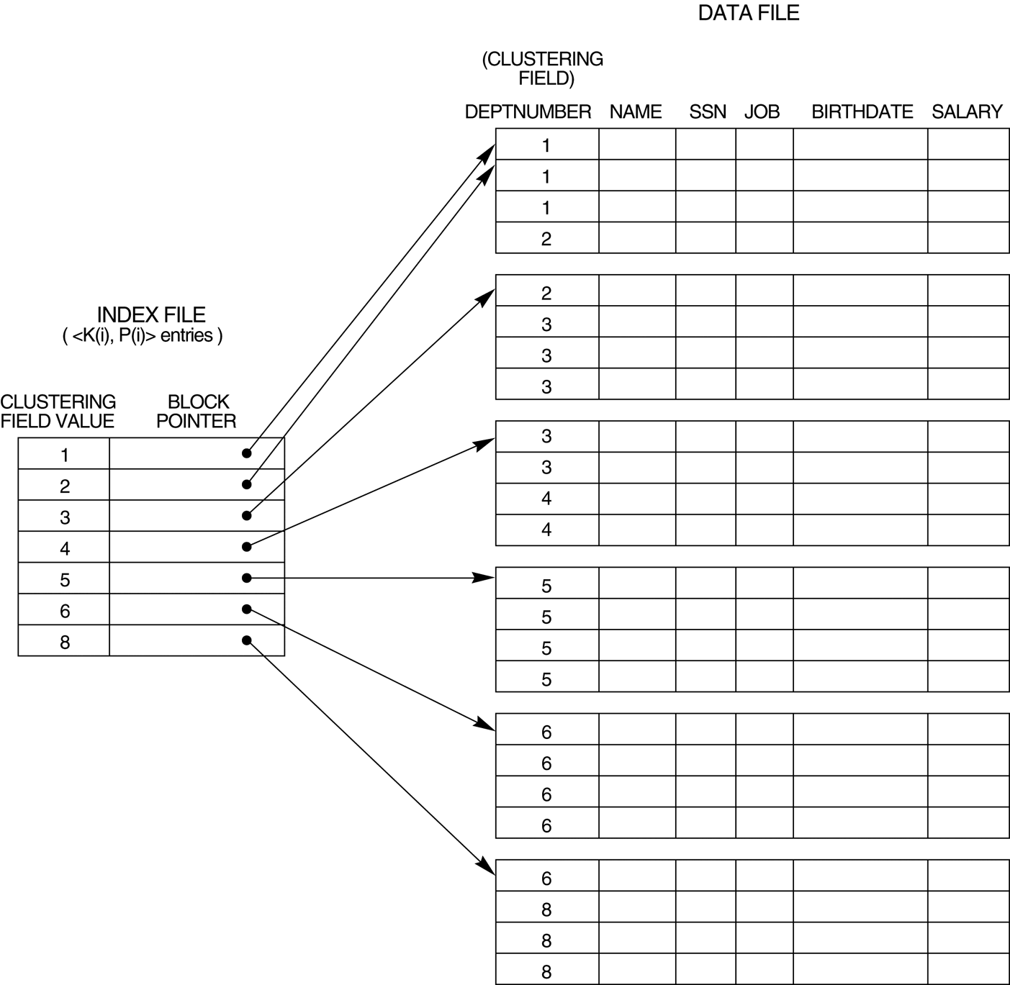
Types of Single-Level Indexes
Figure : A Clustering index on the DEPTNUMBER ordering non-key field of an EMPLOYEE file

Slide 14
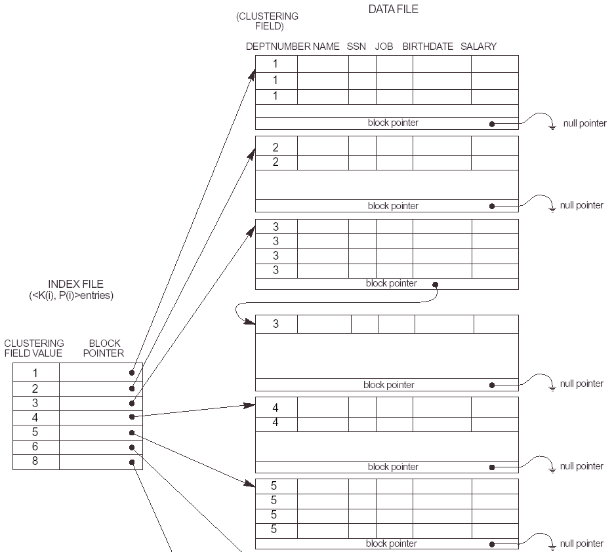
Types of Single-Level Indexes
Another Example

Slide 15
Types of Single-Level Indexes
Secondary Index
  Defined on an unordered data file
  The secondary index may be on
    a key field (with a unique value) in every record, or
    a non-key with duplicate values
  A Secondary index is an ordered file with two fields
    The first field is of the same data type as some non-ordering field of the data file that is an indexing field
    The second field is either a block pointer or a record pointer
    There can be many secondary indexes (and hence, indexing fields) for the same file
  Includes one entry for each record in the data file; hence, it is a dense index

Slide 16
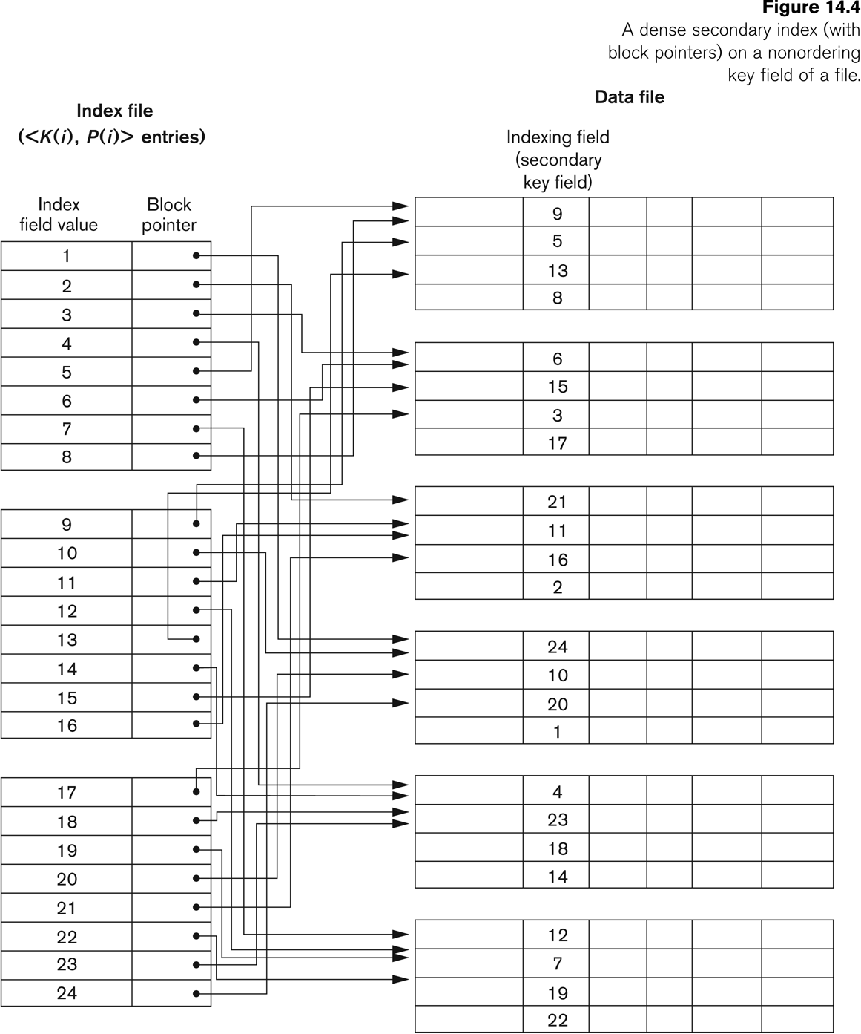

Slide 17
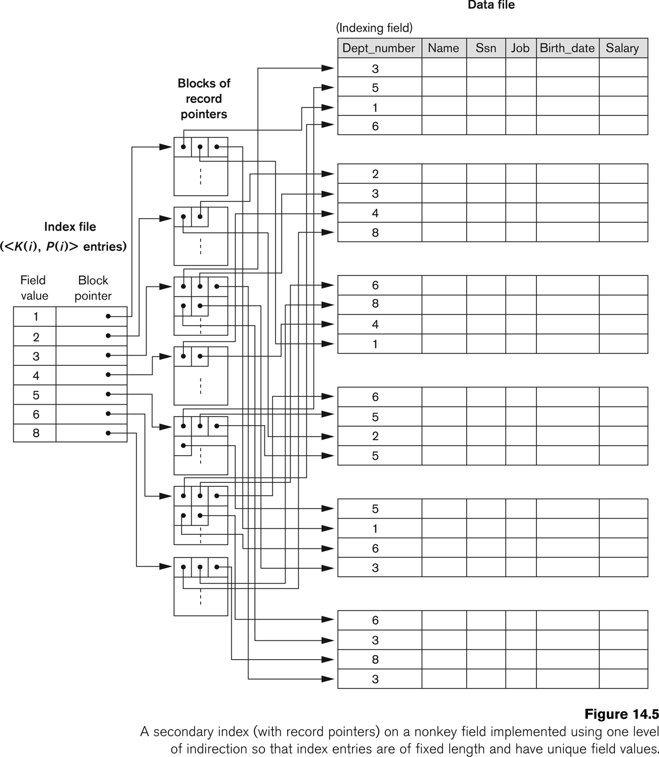

Slide 18
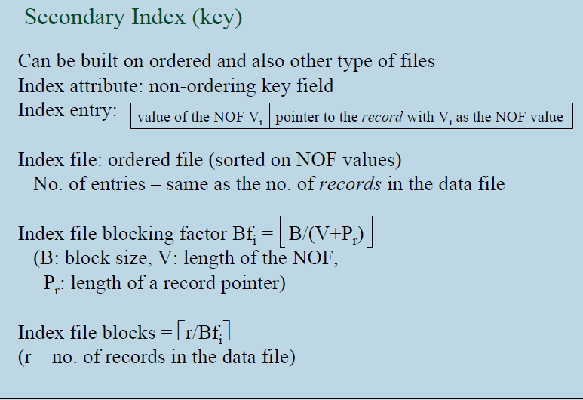

Slide 19
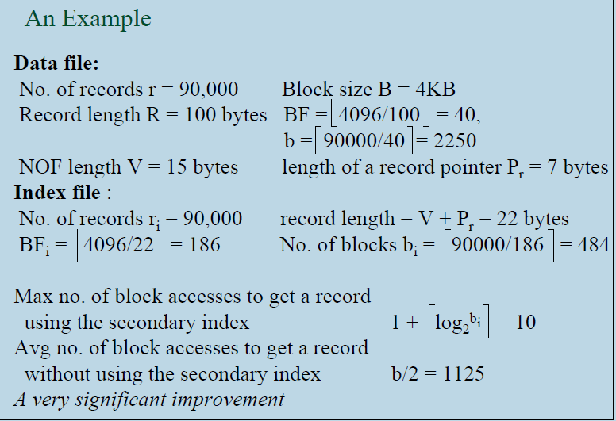

Slide 20
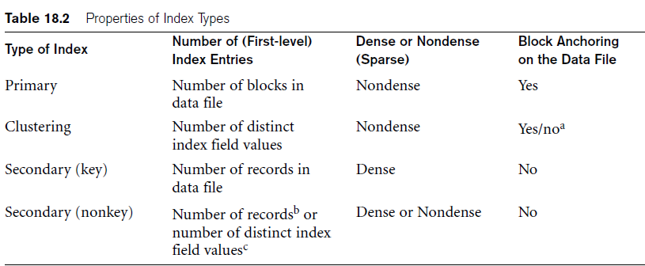
Properties of Index Types

Slide 21
Multi-Level Indexes
Because a single-level index is an ordered file, we can create a primary index to the index itself;
  In this case, the original index file is called the first-level index and the index to the index is called the second-level index
We can repeat the process, creating a third, fourth, ..., top level until all entries of the top level fit in one disk block
A multi-level index can be created for any type of first-level index (primary, secondary, clustering) as long as the first-level index consists of more than one disk block

Slide 22
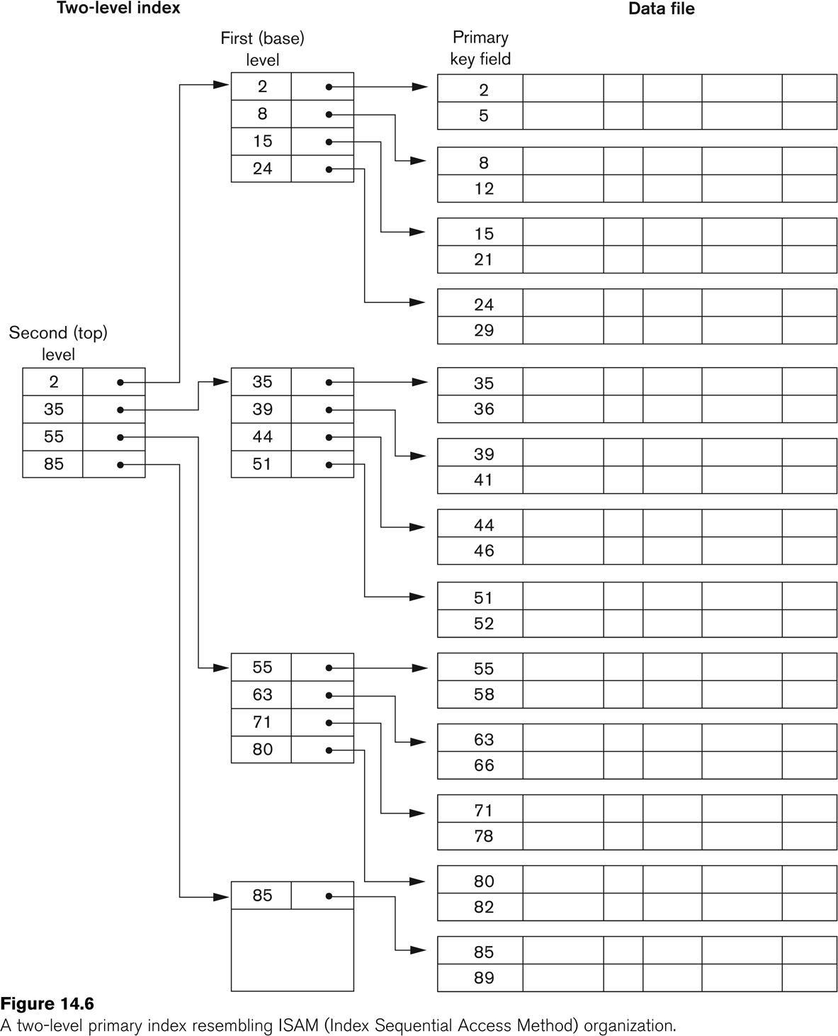
A Two-level Primary Index

Slide 23
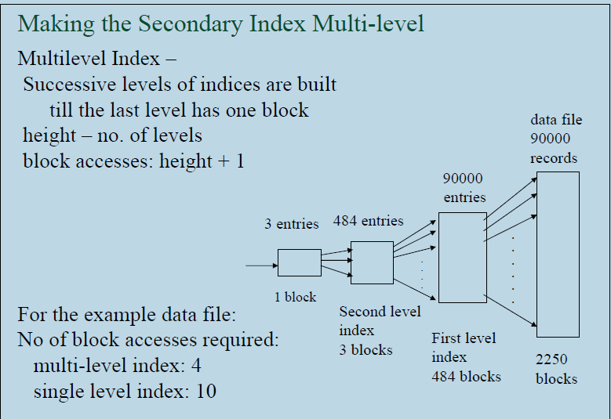

Slide 24
Multi-Level Indexes
Such a multi-level index is a form of search tree
  However, insertion and deletion of new index entries is a severe problem because every level of the index is an ordered file

Slide 25
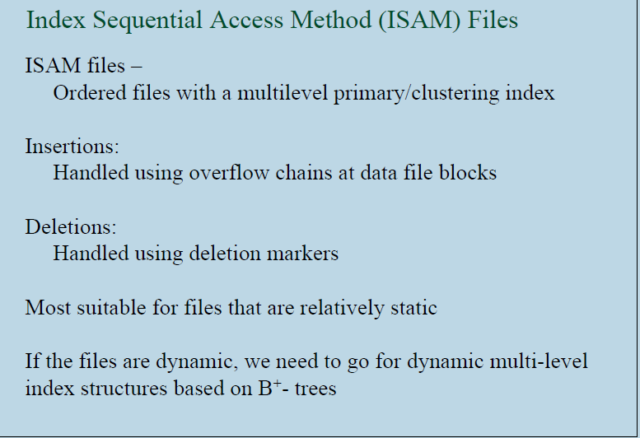

Slide 26
Dynamic Multilevel Indexes Using
B-Trees and B⁺-Trees
Most multi-level indexes use B-tree or B+-tree data structures because of the insertion and deletion problem
  This leaves space in each tree node (disk block) to allow for new index entries
These data structures are variations of search trees that allow efficient insertion and deletion of new search values
In B-Tree and B+-Tree data structures, each node corresponds to a disk block
Each node is kept between half-full and completely full

Slide 27
Dynamic Multilevel Indexes Using
B-Trees and B⁺-Trees
An insertion into a node that is not full is quite efficient
  If a node is full the insertion causes a split into two nodes
Splitting may propagate to other tree levels
A deletion is quite efficient if a node does not become less than half full
  If a deletion causes a node to become less than half full, it must be merged with neighboring nodes

Slide 28
Difference between B-tree and B⁺-tree
In a B-tree, pointers to data records exist at all levels of the tree
In a B+-tree, all pointers to data records exists at the leaf-level nodes
A B+-tree can have less levels (or higher capacity of search values) than the corresponding B-tree

Slide 29
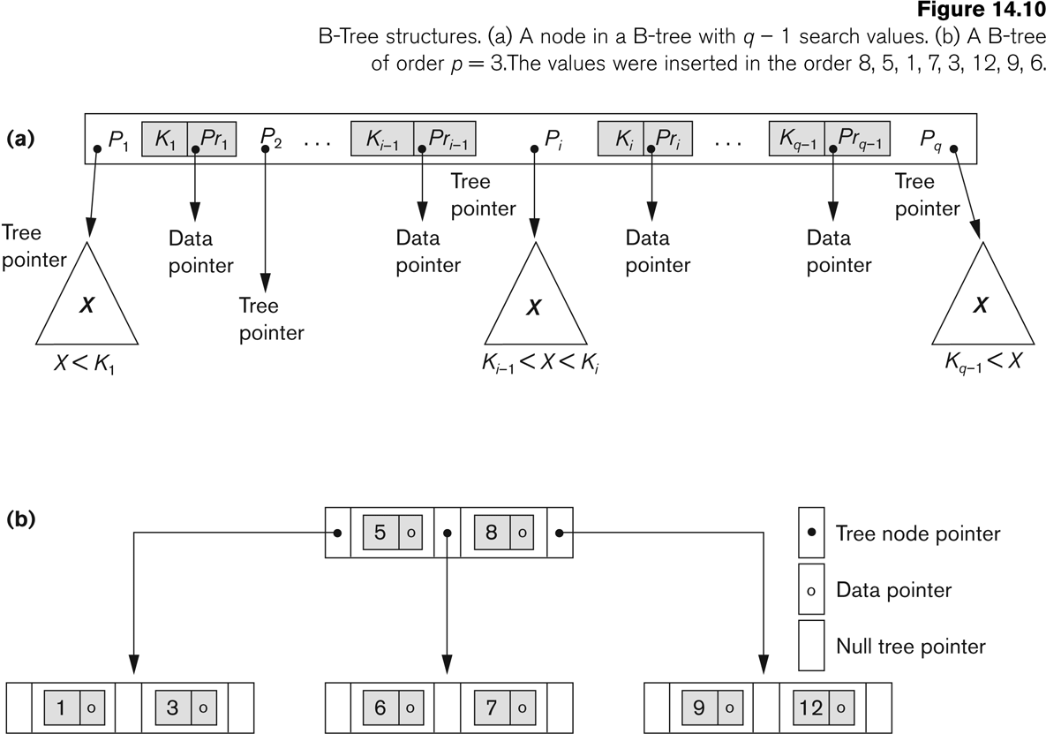
B-tree Structures

Slide 30
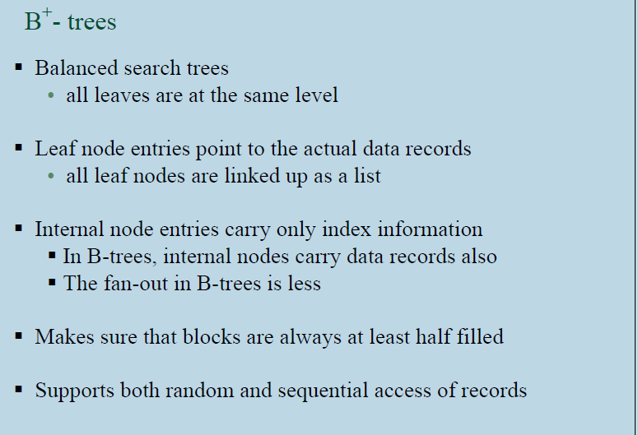

Slide 31
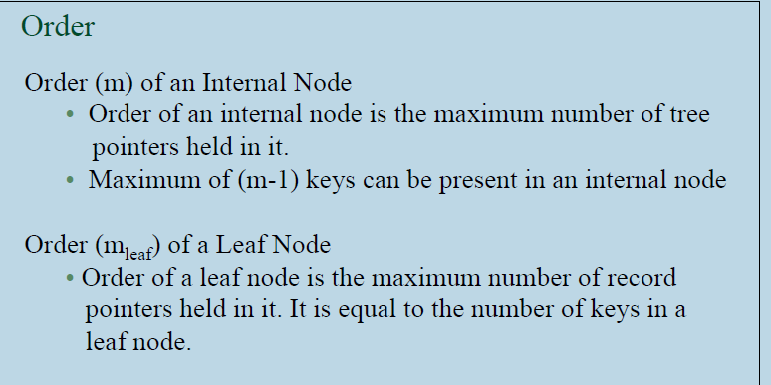
B⁺-tree

Slide 32
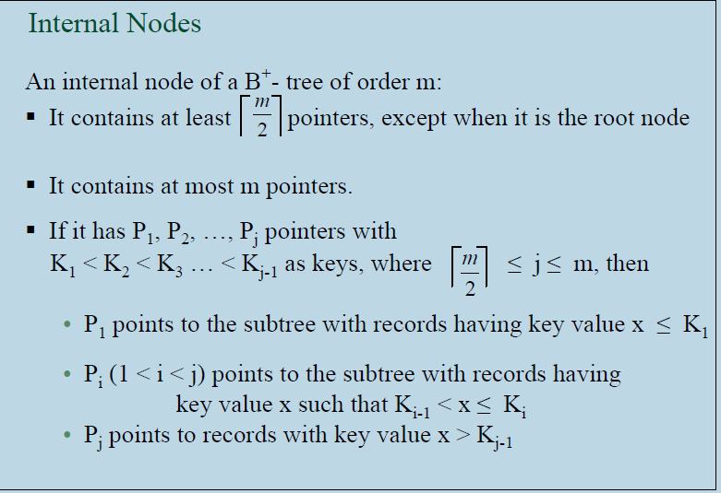

Slide 33
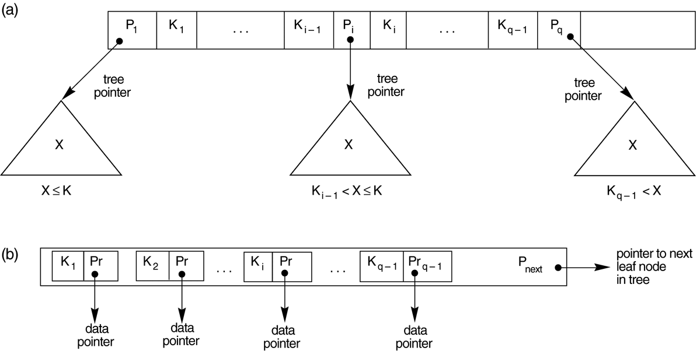
The Nodes of a B⁺-tree
FIGURE 14.11 The nodes of a B+-tree
  (a) Internal node of a B+-tree with q –1 search values.
  (b) Leaf node of a B+-tree with q – 1 search values and q – 1 data pointers.

Slide 34
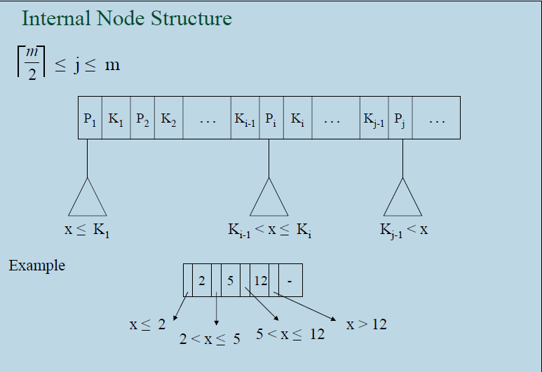

Slide 35
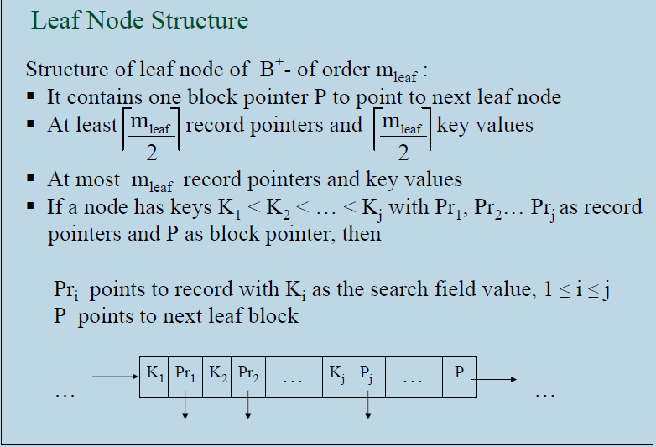

Slide 36
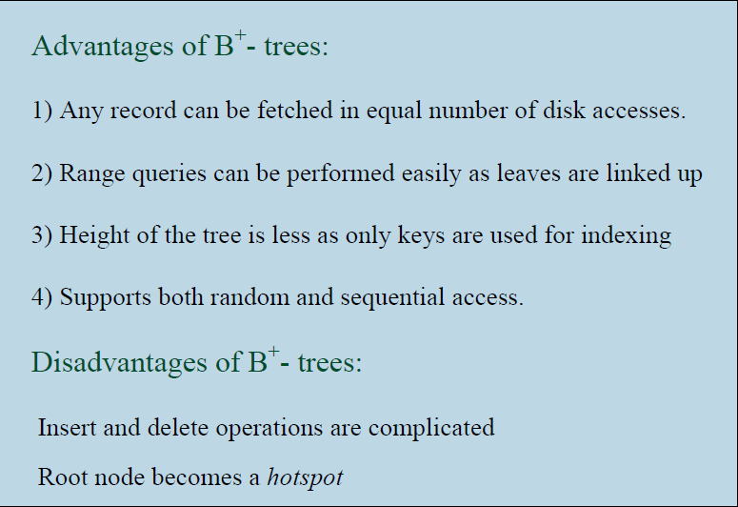

Slide 37
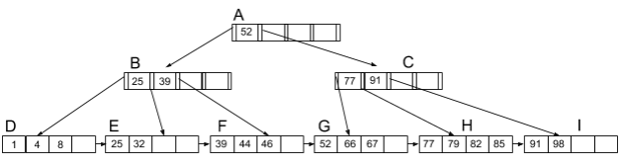
In-class Exercise
Consider the following B+ tree index on the “price” field of a relation Products(itemID int, price int)
Calculate the number of disk I/Os if B+ tree index is used to answer the following query. Brief your calculation.
SELECT * FROM R WHERE PRICE ≥ 39 AND PRICE ≤ 78;

Slide 38
In-class Exercise
We need a total of 12 I/Os
5 index page I/Os: A -> B -> F -> G -> H
7 file page I/Os to fetch records: 39, 44, 46, 52, 66, 67, 77

